Slide 1
Greenwashing and Local Government

Slide 2
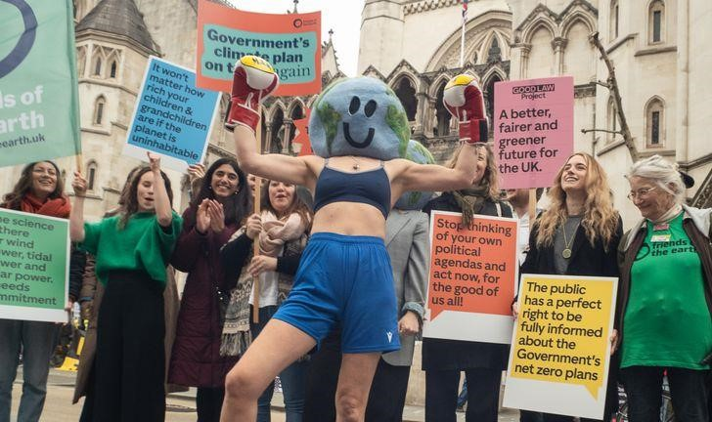
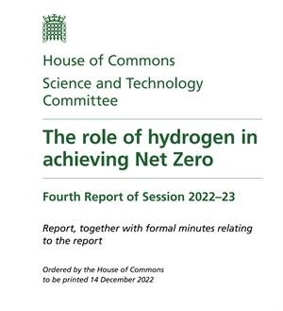
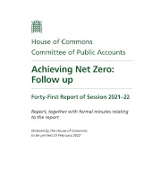
National Government
Before we get to local government, the national case is a useful reference point…
The Climate Change Act 2008 sets duties for Government on climate mitigation and adaptation.
This including a duty to set evidence-based targets and plans, assessed and monitored by the Climate Change Committee – to ensure they accord with legally-binding carbon budgets (i.e. 5-year milestone targets).
Consequently, there are 3 main ways we can scrutinise Government’s plans and delivery…
The Climate Change Committee’s progress reports
Possibility of Judicial Review
Select Committee Evaluations
Select Comm
it
tee
evaluations
Notes:
Climate Change Act sets Gov climate duties & evidence-based targets for legally-binding carbon budgets
,These are assessed and monitored by the independent UK Climate Change Committee (UKCCC)
Robust framework for checking government’s plans and delivery – to see if they are greenwash or not
Three things are key:
UK CCC produces annual evaluations of government progress. No sugarcoating, worth reading
Since they are statutory duties opens the possibility for judicial review.
Another useful source of scrutiny comes from Parliament’s Select Committee’s

Slide 3
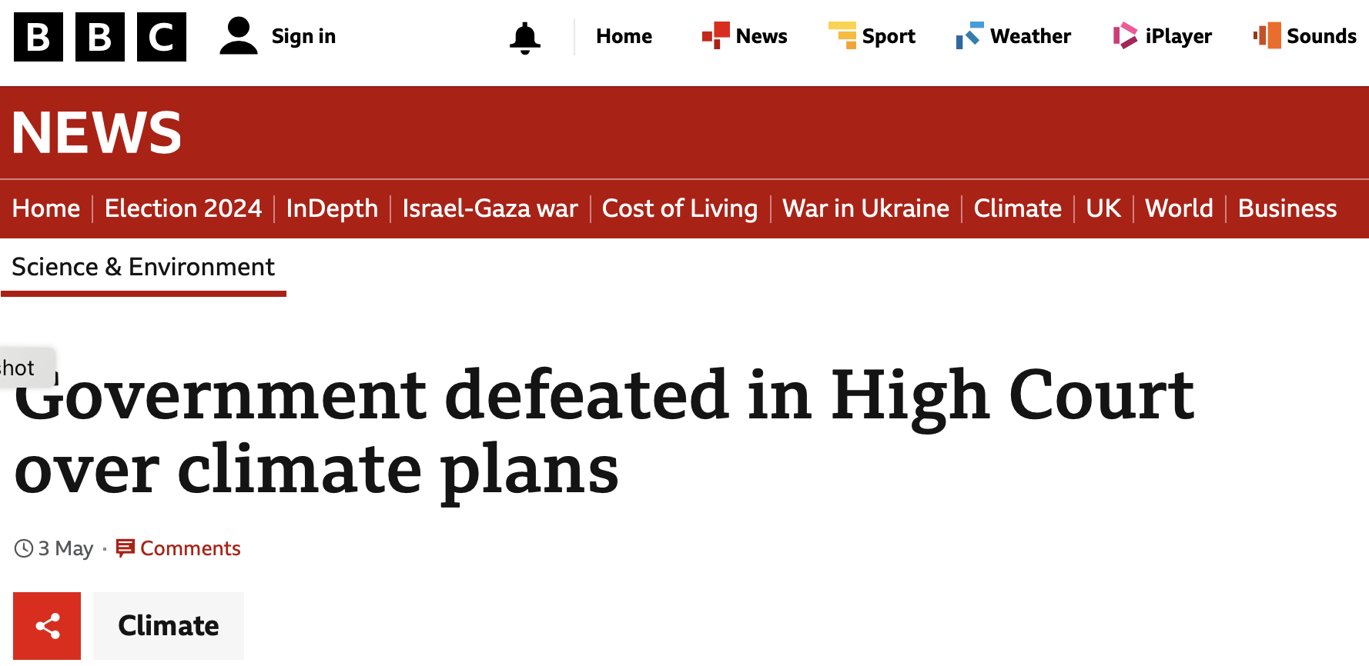
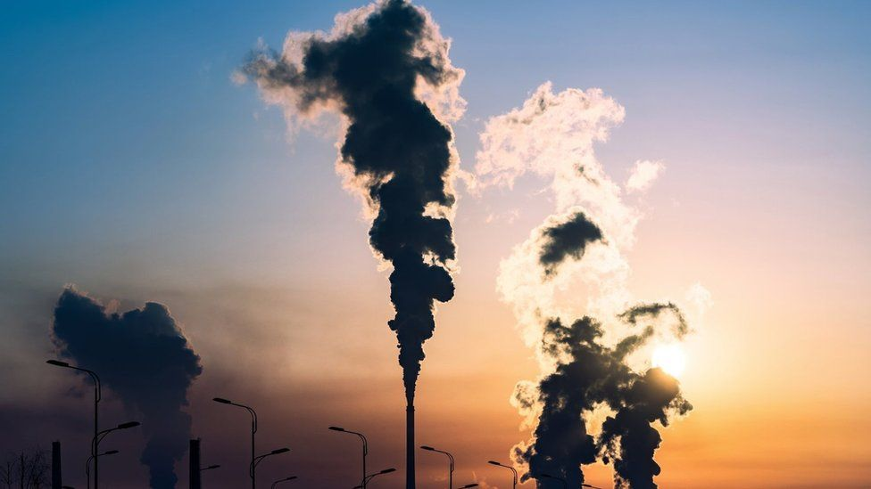
The government has been defeated in court - for a second time - for not doing enough to meet its targets for cutting greenhouse gas emissions.
Environmental campaigners argued that the energy minister signed off the government's climate plan without evidence it could be achieved.
The High Court ruled on Friday that the government will now be required to redraft the plan again.
The legal challenge was brought by environmental groups Friends of the Earth, ClientEarth and The Good Law Project.
The three groups had previously won a case against the government back in 2022 arguing that its Net Zero Plan was not detailed enough to explain how the UK would cut its emissions - as required by the Climate Change Act.
Campaigners said the former Energy Secretary Grant Shapps did not consider the risks to deliver the plan and signed it off assuming all the policies would be achieved.
In his judgement, Mr Justice Sheldon said: "It is not possible to ascertain from the materials presented to the Secretary of State which of the proposals and policies would not be delivered at all, or in full.”
3rd May 2024
Notes:
Legal challenge by Friends of the Earth, ClientEarth and The Good Law Project.
Campaigners claimed the risks had not been considered and the plan assumed all policies would be achievd
Government defeated in court – will be required to redraft the plan again

Slide 4
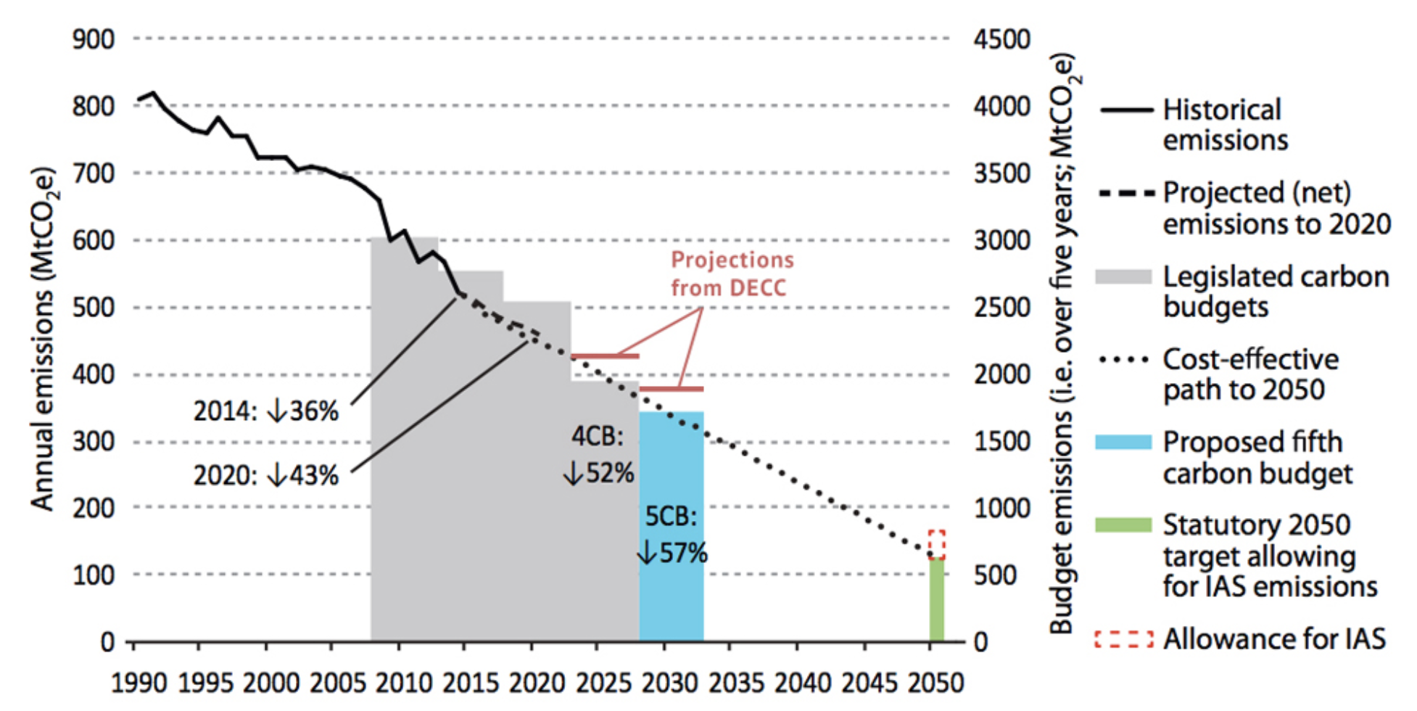
The CCC's recommended UK carbon budgets and the UK's 2050 target
UK’s target: reduce emissions by 78% (2035)
The government’s own climate watchdog warned the plan was not sufficient
UKCCC even less confident in achieving the climate goals than before the new plan was published (2023)
UKCCC estimates the gov plan would only deliver 1/5th emissions cuts needed (10 yrs)
UKCCC criticized the government's failure to support clean energy & support for new Oil & Gas projects
In July 2023 100 new North Sea oil and gas licences granted but the International Energy Agency said there is no need for new projects to meet global energy demand.
Notes:
The government had previously been warned that the plan was not sufficient by its own climate watchdog.
When the new plan was published in March 2023 the UK Climate Change Committee (UKCCC) said it was even less confident that the government could achieve its climate goals than before it published the plan.
The UK has a target to reduce its emissions by 78% by 2035 against 1990 levels. But the UKCCC estimated the government plan would only deliver a fifth of the emissions cuts needed in the coming decade.
It said of the plan published in 2023: "Despite over 3,000 pages of new detail, [our] confidence in the UK meeting its goals from 2030 onwards is now markedly less than it was in our previous assessment a year ago.”
In particular the committee criticized the government's failure to support clean energy and its support for new fossil fuel projects.
In July 2023 Prime Minister Rishi Sunak announced 100 new North Sea oil and gas licences - on the basis this would secure jobs and energy security for the UK.
The International Energy Agency has previously said, external there is no need for investment in new oil and gas projects to meet global energy demand.

Slide 5
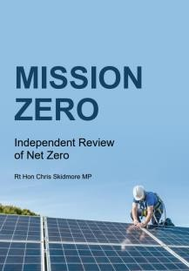
Local Government Context
But, it’s not formally clear how councils fit into national net zero plans for net zero – with them having no real statutory duties nor core funding for climate action (instead relying on competitive funding pots).
In Scotland all public bodies must report on climate change each November.
There is no such responsibility in England yet – but Government has said it will publish guidance on public sector emissions reporting in 2025.
The ‘Independent Review of Net Zero’ identified the lack of a clear framework and lack of statutory duties for councils on net zero as an issue.
The LGA too have made a similar call for a national climate action framework that clarifies council’s roles alongside adequate and stable core funding for council climate action.
Notes:
For local government, the situation is different.
Councils have come to take climate more seriously over recent years. Over 300 now have declared emergencies.
But it is not clear how councils fit into national plans for net zero with no real statutory duties
There is no core funding for action – need to compete against each another for short-term funding pots for think like retrofitting their estates.
This makes it hard to evaluate their performance – many barriers and no level playing field for comparison
No standard reporting in England - Government has promised guidance on reporting in 2025.
The Independent Review of Net Zero from last year identified the lack of a clear framework for councils
The Local Government Association, too, have made similar calls.
This all makes it harder to evaluate local government performance for greenwashing without a set framework.
Thankfully our councils claim they have detailed plans and they do report on their progress to their scrutiny committees.
However much more effort put into 1.5% within their direct control

Slide 6
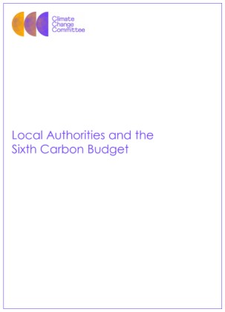
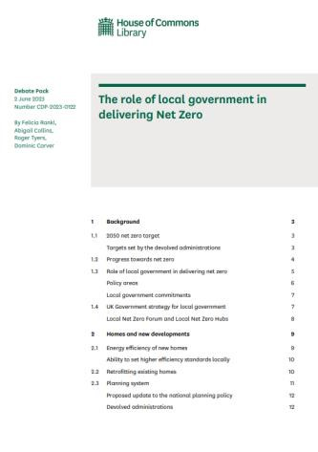
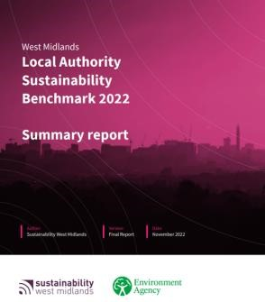
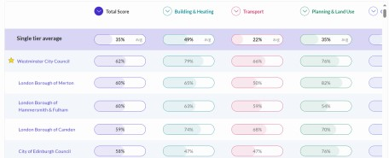
Local Government Barometers
So, how can we evaluate local government performance in lieu of a national framework ?
Th
e Local Govern
me
nt
UK100’s
handbook of loc
The
Commons Libra
al
The Climate Change
ry
’s
Ass
ociation’s 2021
authority net zero power
202
s
3
The role of loc
Committee’s 2020
al
Local
Del
ivering local net z
gov
ernment in reac
ero
Authorities and the Si
hi
ng
xth
rep
or
net
zer
t
,
and
council a
ction
o
briefing not
Carbon Budge
e
t
repor
t
cas
e studie
s
Support and
guidance
Independen
t
Benchmarki
ng and
organisation
s
standards &
comparison
s
accreditation
Notes:
What are the barometers for evaluating their performance?
A few useful documents detail the kinds of roles and exemplify some good practice.
The Climate Change Committee’s 2020 Local Authorities and the Sixth Carbon Budget report
The Commons Library’s 2023 The role of local government in reaching net zero briefing note
The Local Government Association’s Delivering Net Zero report and its database of case studies
Support and guidance from other organisations like Net Zero Go, Net Zero Hubs, and Local Partnerships
Independent standards and accreditation systems, like ISO standards or the Greenhouse Gas Protocol.
Benchmarking exercises, like those of Climate Emergency UK – needs improving

Slide 7
Climate Action UK Scorecards
Dorset Council rated 35/190
BCP Council rated 92/190
The Scorecard assessment consists of 91 questions or less, depending on council type, across 7 different sections, created in consultation with over 90 different organisations and individuals. Each council was marked against these criteria and given a right to reply before the scores underwent a final audit. This work was completed between January and August 2023. Unless otherwise stated, council climate action from 1st January 2019 up until 31st March 2023 was assessed.

Slide 8
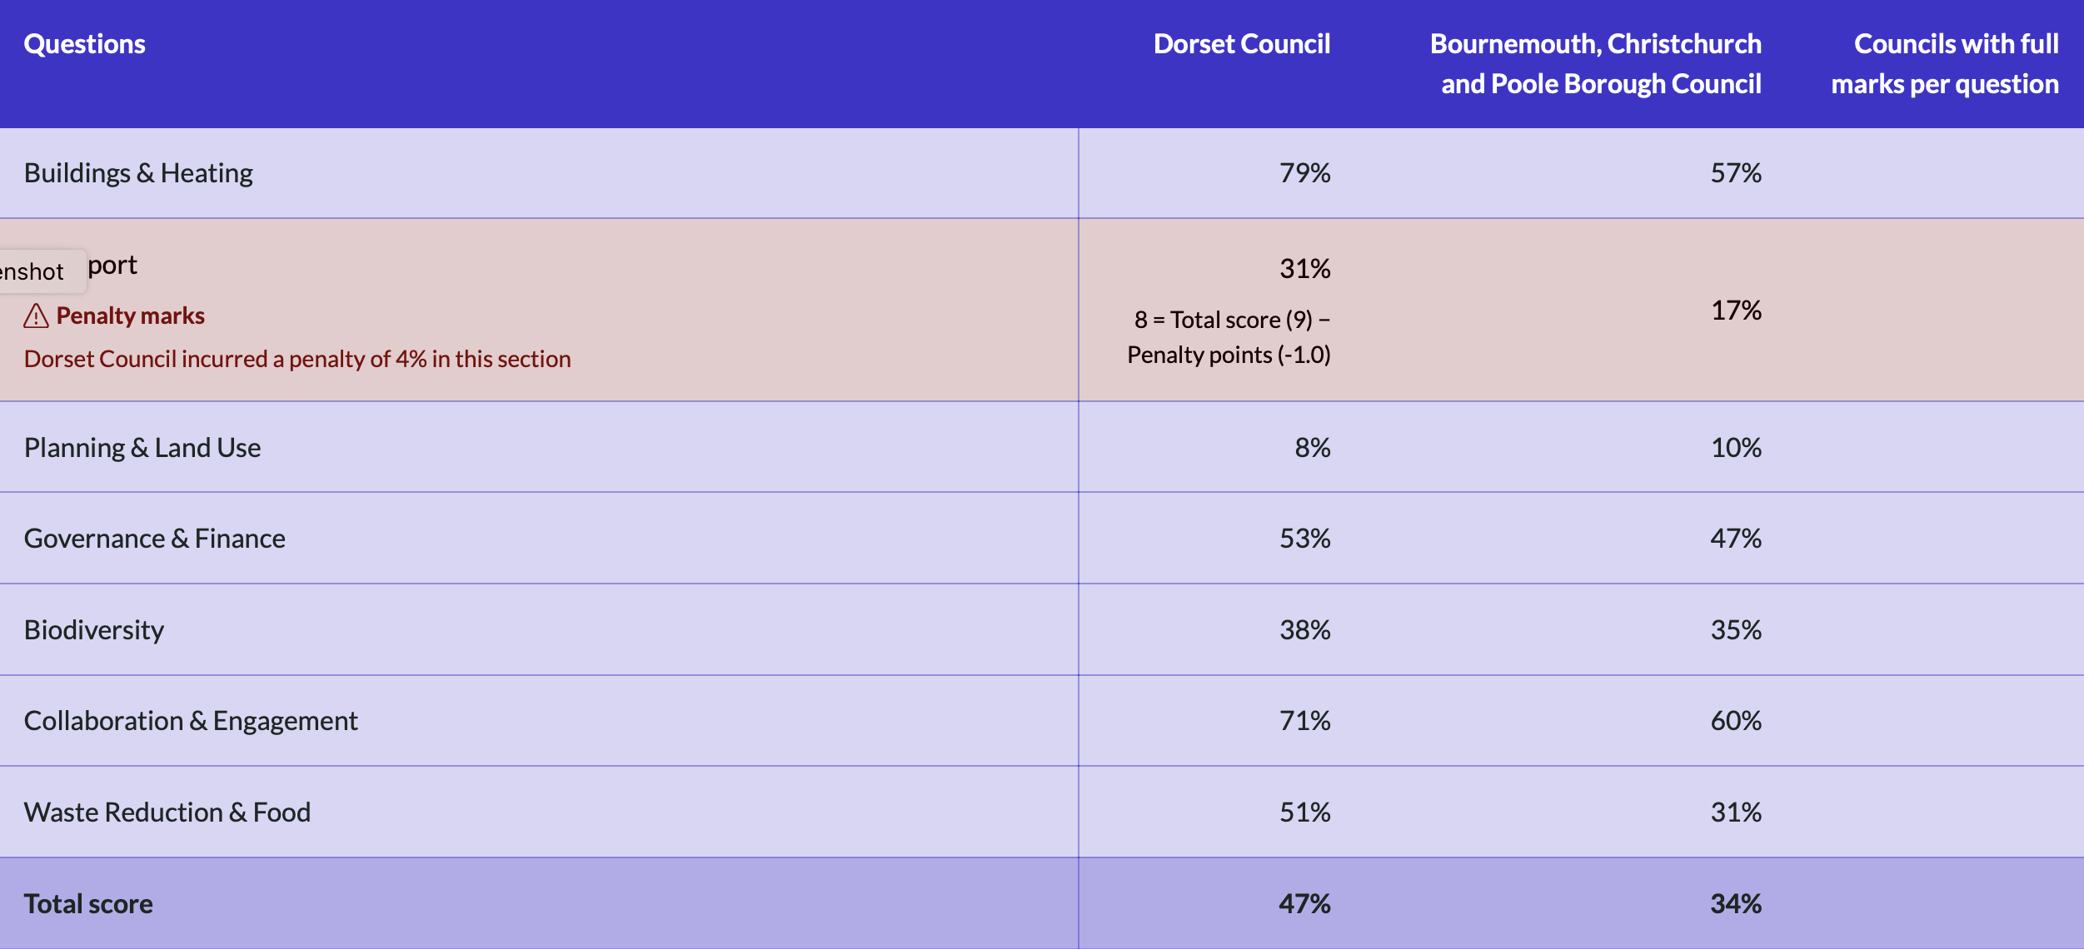

Slide 9
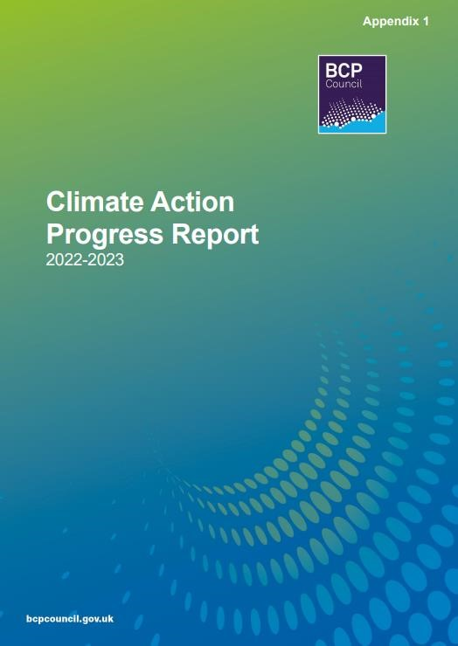
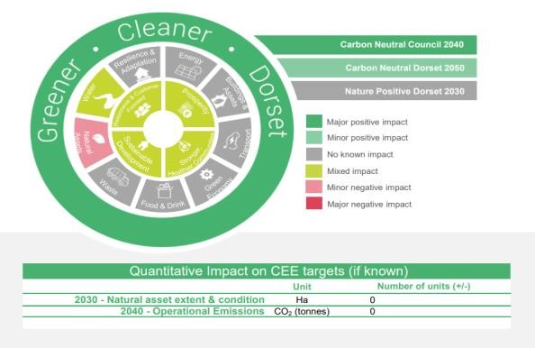
Local Government Plans and Progress Reporting
bcpcouncil.gov.uk/environment/ sustainability-and-carbon- reduction
dorsetcouncil.gov.uk/climatechange
Notes:
Dorset and BCP councils both have generally good reporting mechanisms
Both have detailed strategies and action plans that underpin what they do and why they do it
They both have impact assessments that consider environmental factors in decision-making
Both produce detailed progress reports that they present to their scrutiny committee’s – Dorset Council’s biannually, and BCP’s annually
This is a good basis for their green claims to be evaluated.

